Slide 1
Inverse Kinematics with Deep Learning
Mitchell Todd
Dr. Anoop Grewal (Arizona State University ASA/SEMTE)
2024 Arizona Space Grant Statewide Student Research Symposium

Slide 2
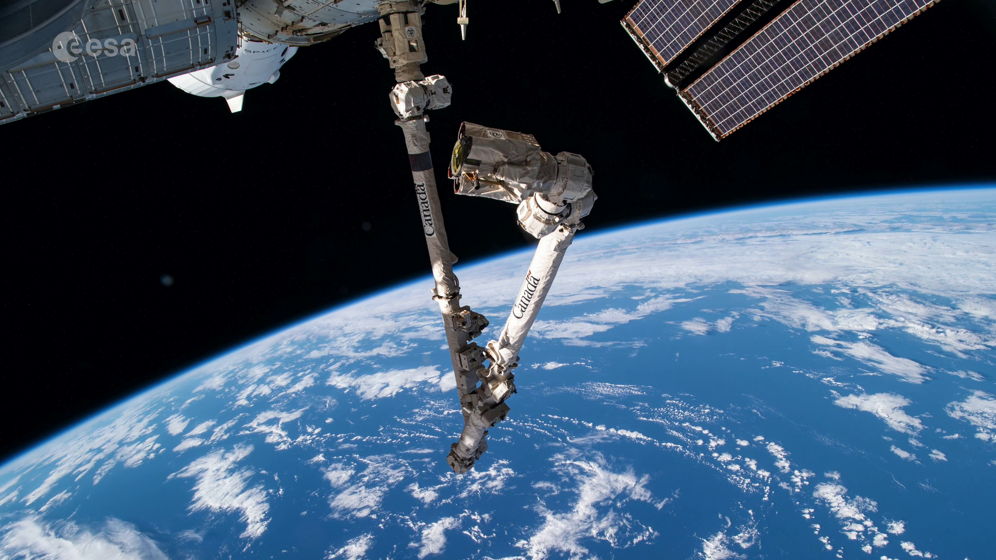
Introduction
As robots are likely to be essential companions in space exploration, it will be useful to “teach” robots to complete common tasks without additional coding.
Deep Learning with Neural Networks!
Excellent for cases when the robot may be unable to be assisted by humans.
Robotic Arm
One of the most common applications of robotics.
“Canadarm” on Space Shuttle.
Requires rigorous computations and code.
Can neural networks streamline this process?

Slide 3
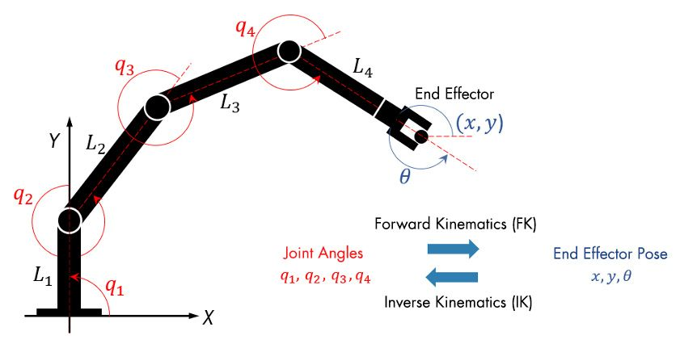
Research
As the degrees of freedom (DOF) of a robotic manipulator increases, determining the analytical solutions to IK becomes increasingly more difficult.
Pre-existing research has yielded promising results:
“Joint space segmentation,” (Lu et al., 2022).
Feedforward with backpropagation (Köker et al., 2004).
Increased accuracy resulting from prioritizing more networks and fewer outputs (Köker, 2013).
Combining genetics, neural networks, and inverse kinematics to overcome nonlinearities (Köker, 2013b).
Notes:
Köker, R. (2013). A genetic algorithm approach to a neural-network-based inverse kinematics solution of robotic manipulators based on error minimization. Information Sciences, 222, 528–543. https://doi.org/10.1016/j.ins.2012.07.051
Köker, R., Öz, C., Çakar, T., & Ekiz, H. (2004). A study of neural network based inverse kinematics solution for a three-joint robot. Robotics and Autonomous Systems (Print), 49(3–4), 227–234. https://doi.org/10.1016/j.robot.2004.09.010
Lu, J., Zou, T., & Jiang, X. (2022). A neural network based approach to inverse kinematics problem for general Six-Axis robots. Sensors (Basel), 22(22), 8909. https://doi.org/10.3390/s22228909
Köker, R. (2013b). A genetic algorithm approach to a neural-network-based inverse kinematics solution of robotic manipulators based on error minimization. Information Sciences, 222, 528–543. https://doi.org/10.1016/j.ins.2012.07.051

Slide 4
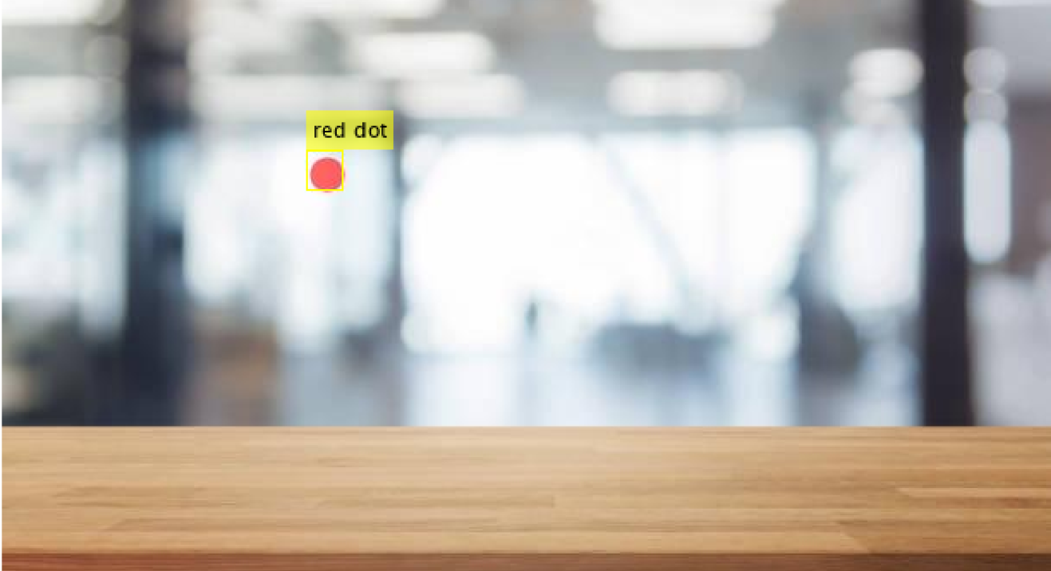
Image Recognition
Before solving IK, the desired position needs to be determined.
Requires a neural network to determine the ( x , y ) location of a red dot placed over an arbitrary background.
Utilized YOLOv2 Deep Learning and MATLAB’s Computer Vision Toolbox.
“You Only Look Once” Version 2.
Widely accepted as one of the most reliable object detection models.
YOLOv2
Divides image into arbitrary grid.
Predicts bounding boxes for each grid cell.
Assigns probabilities of class.

Slide 5
Inverse Kinematics
Networks explored:
FeedForward (FNN)
Input: Receives input data and sends it to subsequent layers.
Hidden layers: Adjusts data as necessary. Adjustments become more accurate with more training.
Output: Provides predicted results.
Function Fitting
Similar structure to FNN, but more specialized towards mapping complex functions.
Fuzzy Logic Neural Networks
Combines the uncertainty of fuzzy logic with neural network learning.
Radial Basis Neural Networks

Slide 6
Inverse Kinematics Results
Initial results yielded unsatisfactory accuracy.
Largely due to the issue of IK having multiple correct solutions.
Issues with formatting training data.
Led to experimentation with different training methods/data pre-processing.
Drastically increasing volume of training data.
Small reductions in error.
Dividing cartesian space into multiple subsections.
Viable, but introduces additional complexity.
Training individual networks for x and y coordinates.
Provided most promising results.
Reasonable accuracy using simple network architecture such as FNN.

Slide 7
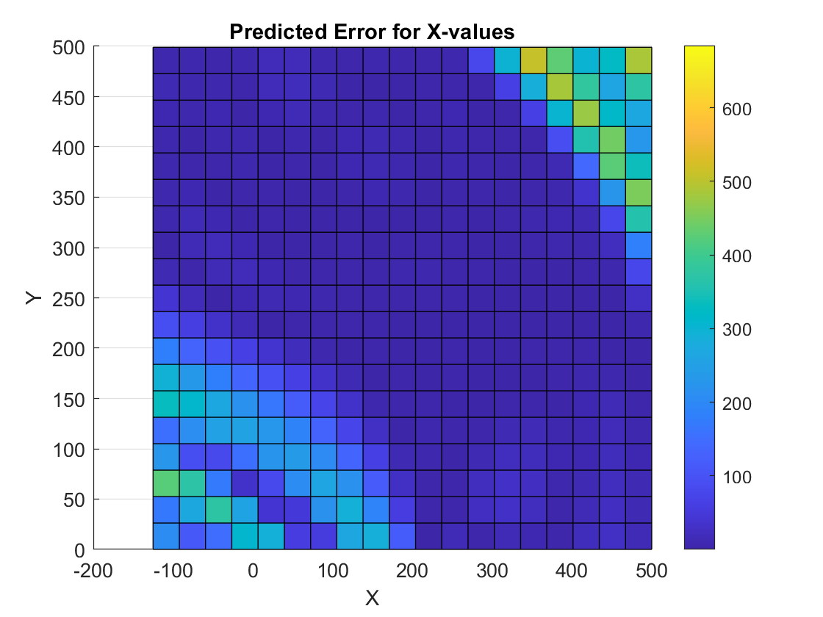
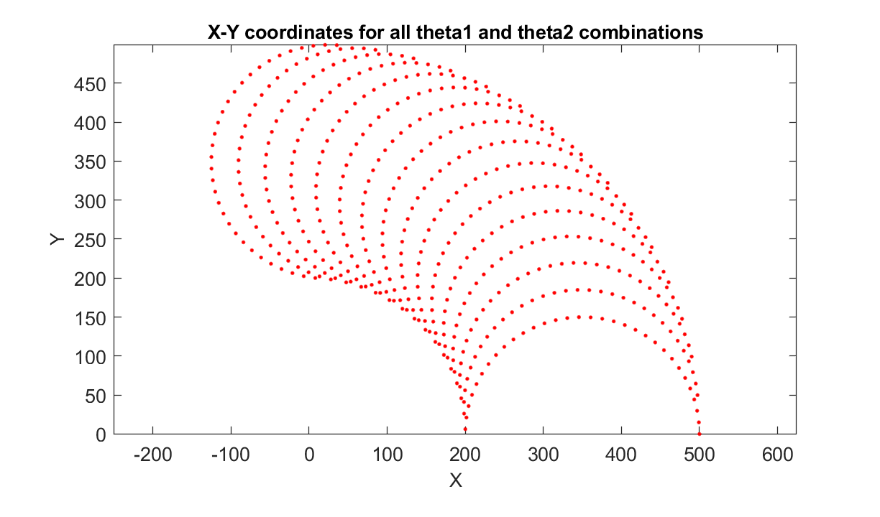
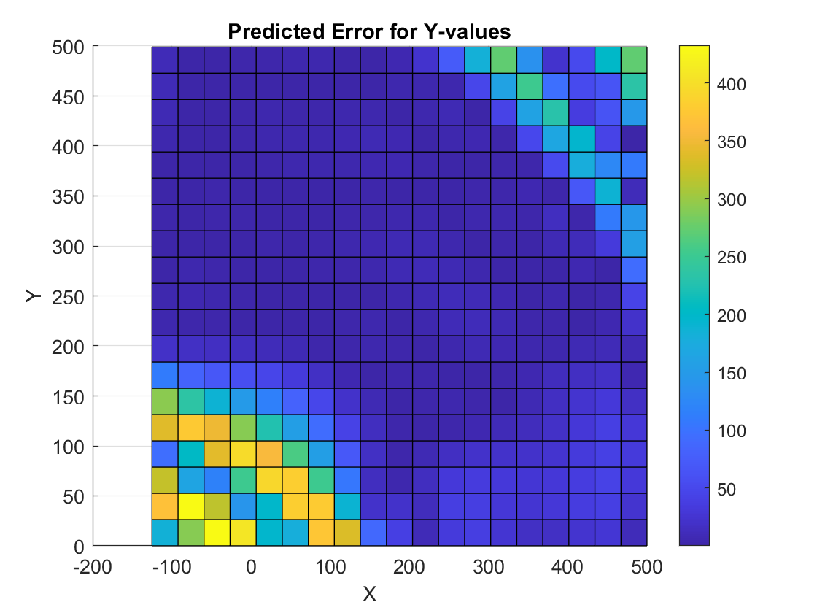
Feed Forward Neural Network
* All plots generated in MATLAB

Slide 8
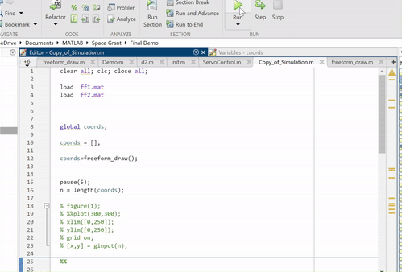
Simulation
Notes:
https://www.youtube.com/watch?v=y0NfUIFHzLU&ab_channel=MitchellTodd

Slide 9
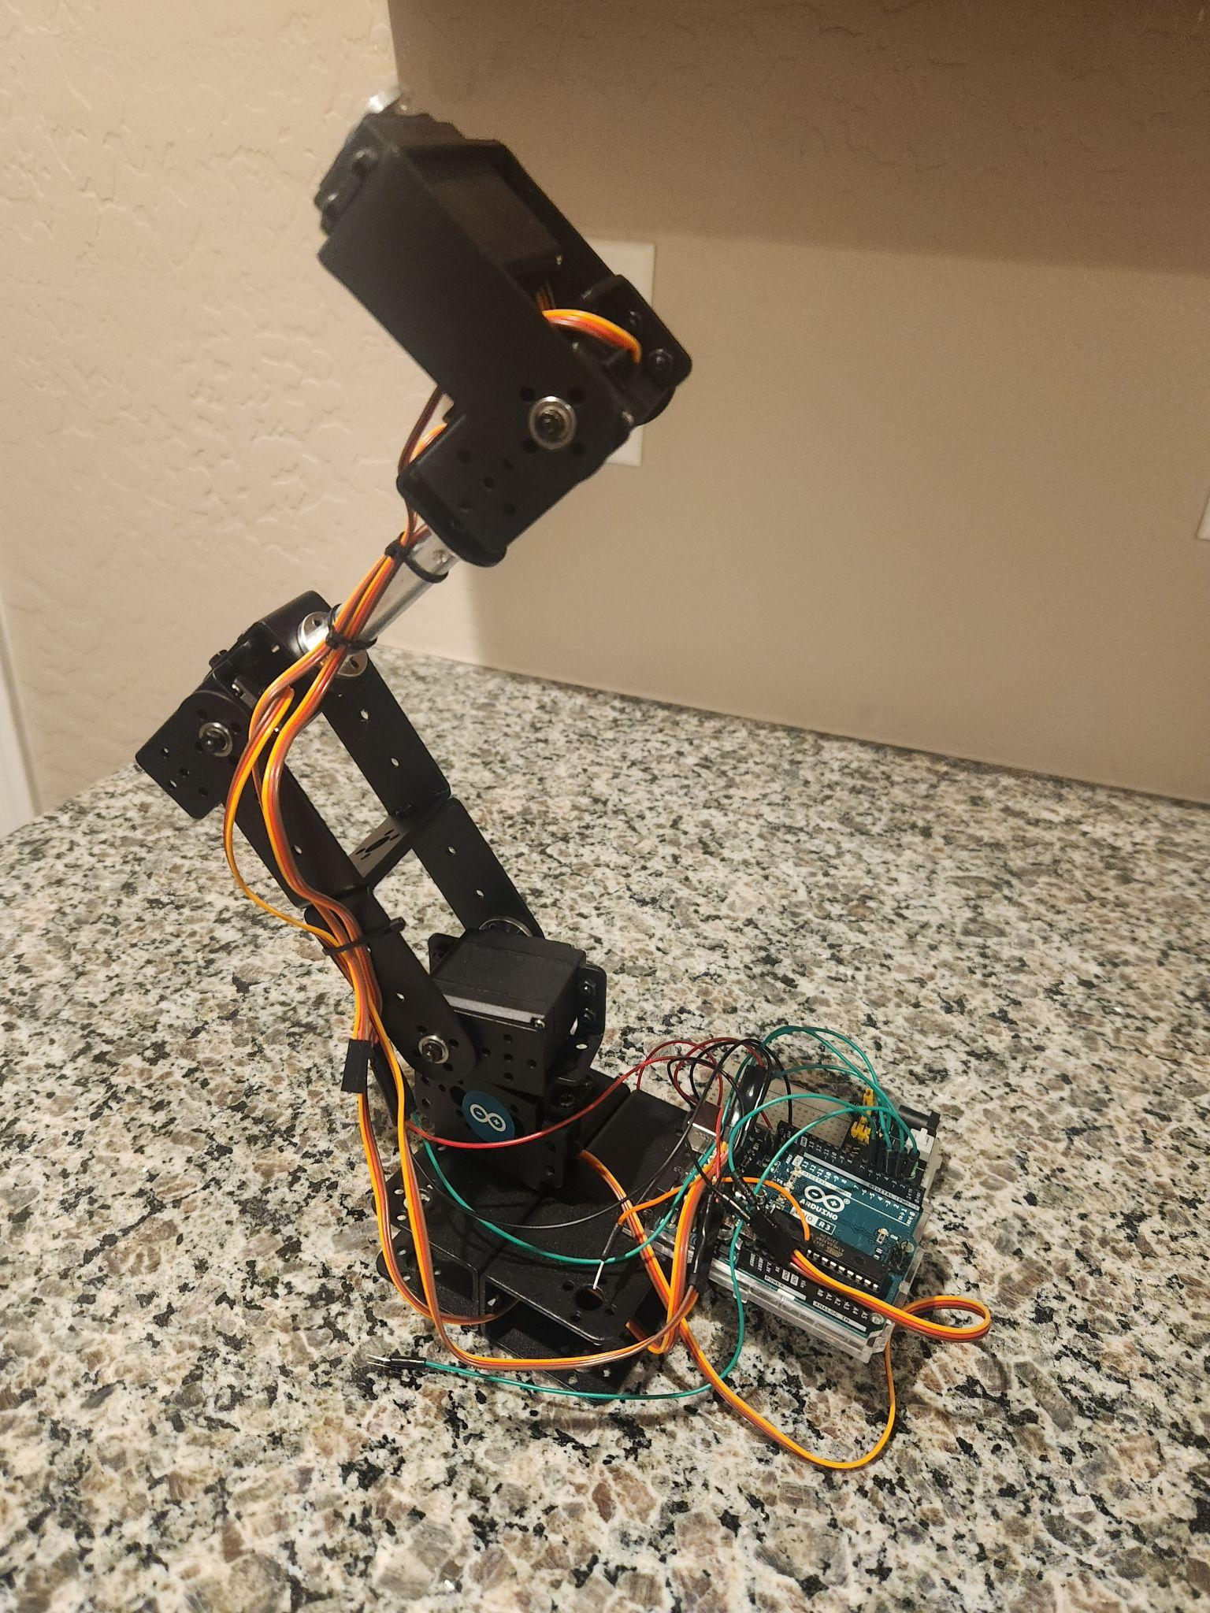
Physical Implementation
Demonstrate viability with a generic robotic manipulator.
Powered by Arduino UNO and MATLAB Arduino Support Package.
Process:
Build 3 DOF arm.
Define a relationship between camera input and arbitrary arm positions.
Integrate pre-trained IK neural networks.
Testing and optimization.

Slide 10
Conclusion
Deep learning is certainly a viable method for solving IK problems.
There is still much room for improving accuracy:
Exponentially more training data.
Further tailoring of neural network structure to IK.
Requires further experimentations with various structure parameters.
Combining the multiple network method with the division of cartesian space?
Future work:
Emphasis on maximizing accuracy.
Experimentation with higher DOF arms.
Refining relationship between computer vision and IK neural networks.

